Slide 1
Welcome to Biol 5081
Intro to Bio Stats!
Eryn McFarlane (she/her), emcfar@yorku.ca, https://github.com/erynmcfarlane

Slide 2
Today we’re going to:
Go over learning objectives of the class
Talk about the basic philosophy of (frequentist) statistics
Talk about the use of simulations, and the summative assessment
Interpret some methods sections of scientific papers in groups

Slide 3
All models are wrong, but some are useful – George Box
When do we use statistics?
What can they tell us?
When do they lead us astray?

Slide 4
Lies, damned lies and statistics – Mark Twain (or possibly Benjamin Disraeli)
Why are you in this class?
What do you hope to gain?
What are your concerns about this class?
What are your concerns about statistics generally?

Slide 5
Learning Objectives
General statistical literacy - can you read a paper and feel confident that you know what they did, or even better, how to do what they did?
Phenomenological understanding of how distributions come to be. Why do we expect data to look this way? How do you expect your data to look?
Writing skills - how do we describe statistical methods? How should we report results?
Some level of comfort coding in R, or, finding R code and applying it.
The application of specific statistical methods, and R, to a question you would like to answer

Slide 6
This course is not:
Where you’re going to memorize all the different tests, parametric and non-parametric.
Where you’re going to have to do any statistics *by hand*
Where you’re going to be asked to write any code without the use of the internet, or even chatGPT (although we will definitely talk about reasons to be cautious with this!)
A place where you’re expected to be perfect, know all the things, or be right all the time – I’m just hoping to move the distribution of your knowledge

Slide 7
Assignments for this class:
- 10% attendance and attempts, where code (or something) is written in 5/6 of the first lectures. Just need to hand 5 things in to get full marks. They don't need to work, you just need to show good faith effort!
- 30% summarize a published paper, simulate data (and justify the simulations) to match the data as have been describe, write analyses in R to analyze the data as has been described (possibly done in a group?) - due at end of week 7, where week 7 is a work period
- 60% registered report with a short (2pg) introduction, methods, and specific statistical methods to match a project in the student's thesis. Possibly following [Nature Ecology Evolution](https://www.nature.com/natecolevol/submission-guidelines/registeredreports), or [Ecology and Evolution](https://onlinelibrary.wiley.com/page/journal/20457758/homepage/registeredreports.html) guidelines.

Slide 8
Registered Report
- 60% registered report with a short (2pg) introduction, methods, and specific statistical methods to match a project in the student's thesis. Possibly following [Nature Ecology Evolution](https://www.nature.com/natecolevol/submission-guidelines/registeredreports), or [Ecology and Evolution](https://onlinelibrary.wiley.com/page/journal/20457758/homepage/registeredreports.html) guidelines.
- this will be broken down into:
1) draft experimental methods for feedback (10%) - week 4
2) draft of statistical methods with proposed simulations and methods for feedback (10%) - week 8
3) feedback on someone else's code (5%) - week 9
4) draft introduction for feedback (10%) - week 10
5) full registered report, including introduction, methods, statistical methods, simulations and simulated results (25%) - due during exam period

Slide 9
What is a model?

Slide 10
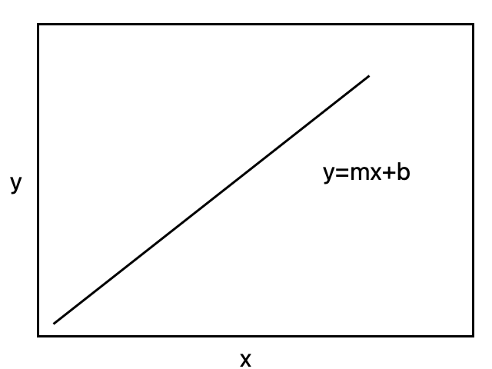
Linear models
Most statistical tests are special cases of a linear model
Once you understand a linear model, you can work out the appropriate test

Slide 11
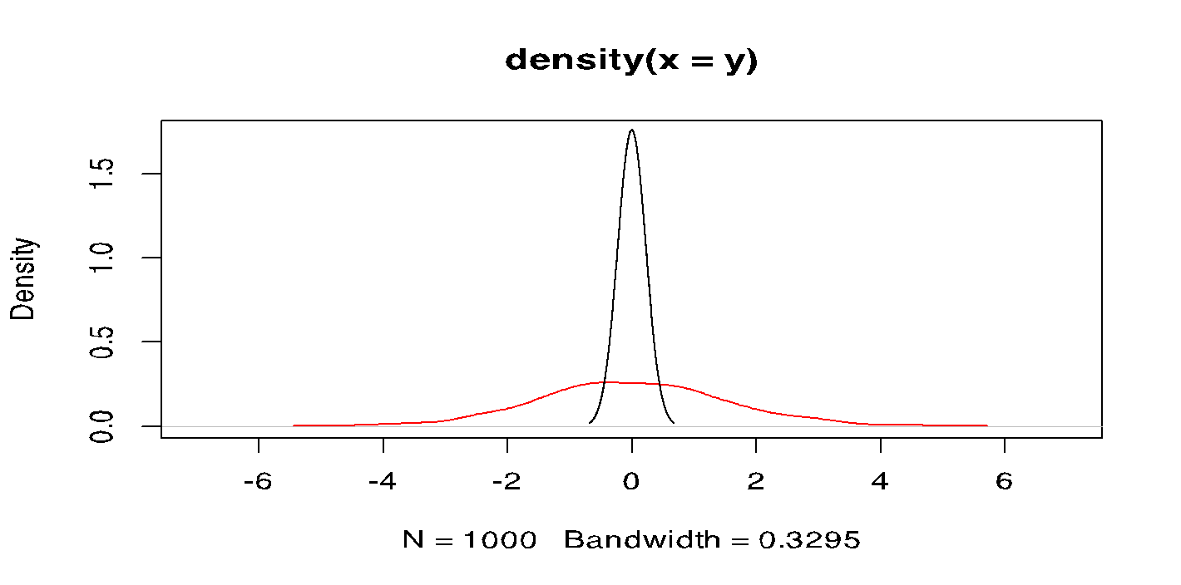
Linear models
Another way to think about this is, what do I think the underlying distributions of each data set is here?
Notes:
Density plots, where the red plot is where I’m simulated an effect, and black plot where there’s no effect of x on y. So these are distributions of y

Slide 12
Linear models
Notes:
What’s the problem here?! Has anyone ever seen a plot like this in their own work?

Slide 13
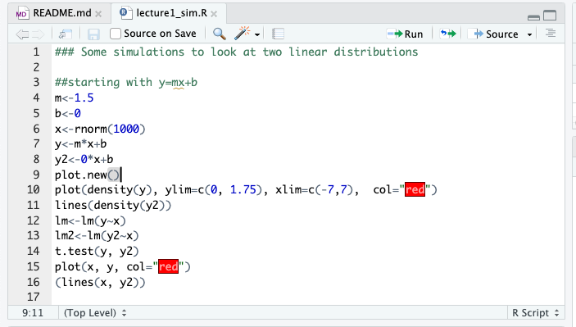
Notes:
Let’s walk through, line by line, what I’ve done here. This is on my github too, so you can get the code from there – only go to line 16.

Slide 14
What’s missing in the data?!

Slide 15
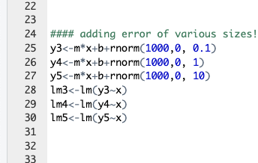
Error

Slide 16
Error

Slide 17
Error
Notes:
Are these lines all statistically significant? Why or why not?
Actually, they all are! The underlying causal pattern is literally the same. There is an effect of x on y. And there’s a lot of data here! But, it gets harder to see with lots of noise, and it means less biologically with lots of noise.

Slide 18
Reducible error vs. Irreducible error
Reducible error: variation in response that arises directly from causal predictors
Irreducible error: variation in response that arises from other unmeasured, or stochastic processes (noise!)
Jahner et al. in prep

Slide 19
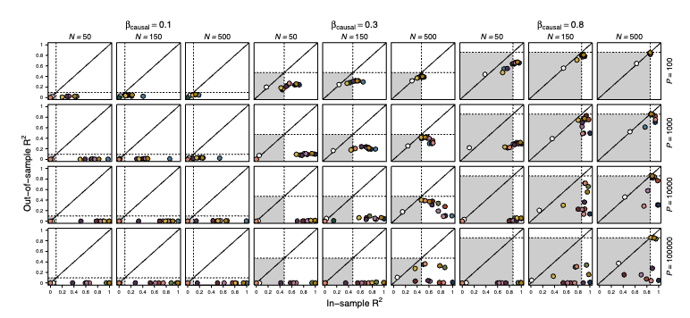
Reducible error vs. Irreducible error
Reducible error: variation in response that arises directly from causal predictors
Irreducible error: variation in response that arises from other unmeasured, or stochastic processes (noise!)
Jahner et al. in prep

Slide 20
COFFEE

Slide 21
What is a simulation, and why do I think it’s a good idea to know how to do these?
We are going to make up data.

Slide 22
What is a simulation, and why do I think it’s a good idea to know how to do these?
We are going to make up data.
We’re actually going to make up tons of data.

Slide 23
What is a simulation, and why do I think it’s a good idea to know how to do these?
We are going to make up data.
We’re actually going to make up tons of data.
Why is this okay?

Slide 24
What is a simulation, and why do I think it’s a good idea to know how to do these?
We are going to make up data.
We’re actually going to make up tons of data.
Why is this okay?
What can we do with these data?

Slide 25
What is a simulation, and why do I think it’s a good idea to know how to do these?
We are going to make up data.
We’re actually going to make up tons of data.
Why is this okay?
What can we do with these data?
Power analyses, description of expectations, null distributions, trials of analyses before we get the data

Slide 26
What is a simulation, and why do I think it’s a good idea to know how to do these?
We are going to make up data.
We’re actually going to make up tons of data.
Why is this okay?
What can we do with these data?
Power analyses, description of expectations, null distributions, trials of analyses before we get the data
What can’t we do with these data?!

Slide 27
Coffee – if needed?

Slide 28

How to read a methods section (which is a good intro to how to write one!)
We’re going to spend an hour doing this:
You can work in groups if you like, or alone if you like.
I want you to read this paper https://onlinelibrary.wiley.com/doi/full/10.1002/ece3.3987 (surprise, it’s one of my papers!) and write out, step by step (approximately 10 steps) what we did and how.
You don’t need to understand every step, but some will be more universal than others!
This will be an assignment (on a paper of your choosing) due week 7.
There is a link to hand in what you’ve done on eClass – it goes to crowdmark
Find the paper here!

Slide 29
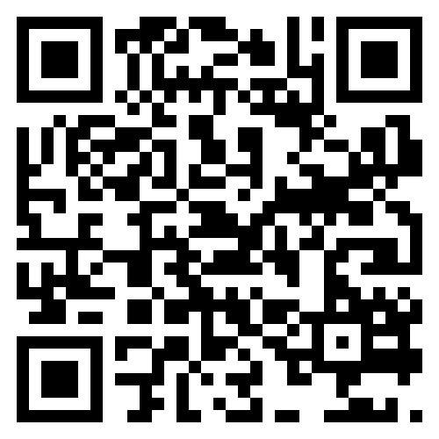
FOR NEXT WEEK:
Set up github or similar before I get here! https://happygitwithr.com/rstudio-git-github
We’re going to talk about and simulate distributions! Think about what the response variable (y!) is that you’re interested in.
Find this useful tutorial here!

